Slide 1
ELIMINATING AMBIGUITY

Slide 2
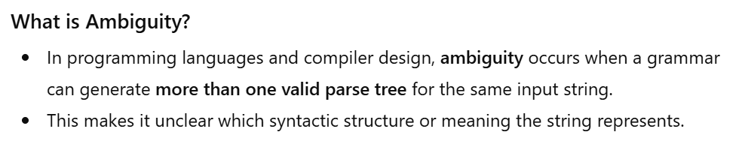

Slide 3

Eliminating Ambiguity
Ambiguity occurs when a grammar can generate more than one parse tree (or derivation) for the same string.
This is bad for compiler design because the meaning of a program becomes unclear.

Slide 4
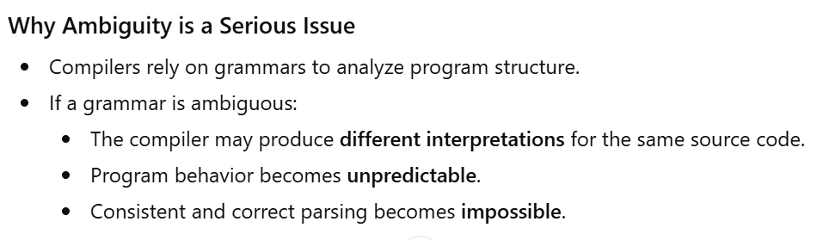

Slide 5
Importance of Eliminating Ambiguity
Ensures unique parse tree for each valid input
Guarantees correct syntax analysis
Helps in generating reliable intermediate and target code
Essential for building efficient and deterministic compilers

Slide 6
Causes of Ambiguity
Why Does Ambiguity Arise?
Grammar allows multiple interpretations of the same string
No clear rules for:
Operator precedence
Operator associativity
Overlapping production rules

Slide 7
Ambiguity Example – Arithmetic Expression
3 + 4 * 5
Possible Interpretations
(3 + 4) * 5 → Addition first
3 + (4 * 5) → Multiplication first
Different interpretations lead to different results
Ambiguity arises due to missing precedence rules

Slide 8
Ambiguous Grammar Example
Ambiguous Grammar for Expressions
  E → E + E
  E → E * E
  E → (E)
  E → id
Issue
Grammar does not define precedence between + and *
Allows multiple parse trees for the same expression

Slide 9
Ambiguity Demonstration
Input String
id + id * id
Valid Parse Interpretations
(id + id) * id
id + (id * id)
✔ Both are syntactically valid
❌ Results are different

Slide 10
Methods to Eliminate Ambiguity
Techniques Used
  Rewriting the grammar
  Operator precedence and associativity rules
  Semantic actions
  Left recursion elimination

Slide 11
Explanation of Rewritten Grammar
Meaning of Non-Terminals
E → Expression (handles addition)
T → Term (handles multiplication)
F → Factor (identifier or parenthesized expression)
Result
Multiplication has higher precedence than addition
Grammar becomes unambiguous

Slide 12
Refactoring the Grammar
Rewrite grammar to make precedence explicit
Separate operators based on priority
Unambiguous Grammar
  E → E + T | T
  T → T * F | F
  F → (E) | id

Slide 13
Correct Interpretation After Rewriting
Expression
id + id * id
Parsed As
id + (id * id)
✔ Correct precedence
✔ Single valid parse tree

Slide 14
Method 2 – Operator Precedence Rules
Operator Precedence
Defines which operator is evaluated first
Example:
* has higher precedence than +
Benefit
Prevents multiple interpretations of expressions

Slide 15
Operator Associativity Rules
Associativity
Determines grouping when operators have same precedence
Example
Left Associative: a + b + c → (a + b) + c

Slide 16
Method 3 – Semantic Actions
Using Semantics to Resolve Ambiguity
Grammar may remain ambiguous syntactically
Meaning resolved using semantic rules
Examples
Type checking
Context-based evaluation
Operand compatibility checks
✔ Used during parsing
✔ Helps in correct interpretation

Slide 17
Method 4 – Left Recursion
Left Recursive Grammar
E → E + T
E → T
Problems
  Causes infinite recursion
  Difficult for top-down parsers
  Can introduce ambiguity

Slide 18
Eliminating Left Recursion
Right Recursive Form
  E → T E'
  E' → + T E' | ε
  T → id | (E)
  Advantages
  Suitable for predictive parsing
  Removes left recursion
  Simplifies parsing process

Slide 19
Terminal symbol:
A terminal is a basic symbol of a grammar that cannot be replaced or expanded further.
Non-terminal symbol:
A non-terminal is a syntactic variable used to define language structures through production rules.

Slide 20
Terminal Symbols
Definition
Terminals are the basic symbols of a language.
They cannot be broken down further using grammar rules.
They appear in the final output string of the grammar.
Terminals are usually produced by the lexical analyzer (lexer).
Terminals represent actual tokens in the source program.

Slide 21
Terminal Symbols
Examples
Keywords: if, else, while, int
Operators: +, -, *, /
Identifiers: id
Constants: num
Special symbols: (, ), {, }, ;

Slide 22
Non-Terminal Symbols
Definition
Non-terminals are syntactic variables.
They represent language constructs or intermediate structures.
They are expanded further using production rules.
They do not appear in the final derived string.

Slide 23
Non-Terminal Symbols
Examples
E → Expression, T → Term, F → Factor, S → Statement
Key Point
Non-terminals help define the structure and hierarchy of the language.

Slide 24
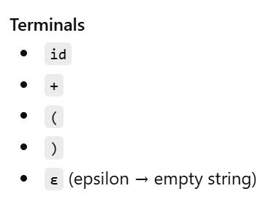
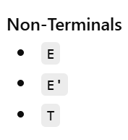
Example Grammar
E → T E'
E' → + T E' | ε
T → id | (E)

Slide 25
Aspect | Terminal | Non-Terminal
Definition | Basic symbols | Syntactic variables
Can be expanded? | ❌ No | ✔ Yes
Appears in final string | ✔ Yes | ❌ No
Example | +, id, if | E, T, S
Used by | Lexer | Parser

Slide 26
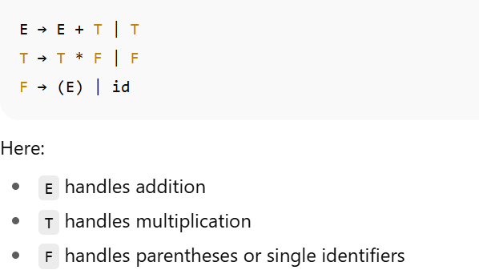
unambiguous form:

